Slide 1
Master’s Defense
Kyle Coapman
June 10, 2020

Slide 2
Agenda
Introduction and Context
Student Academic Results
Student Character Results
Portfolio Entries
Key Insights

Slide 3
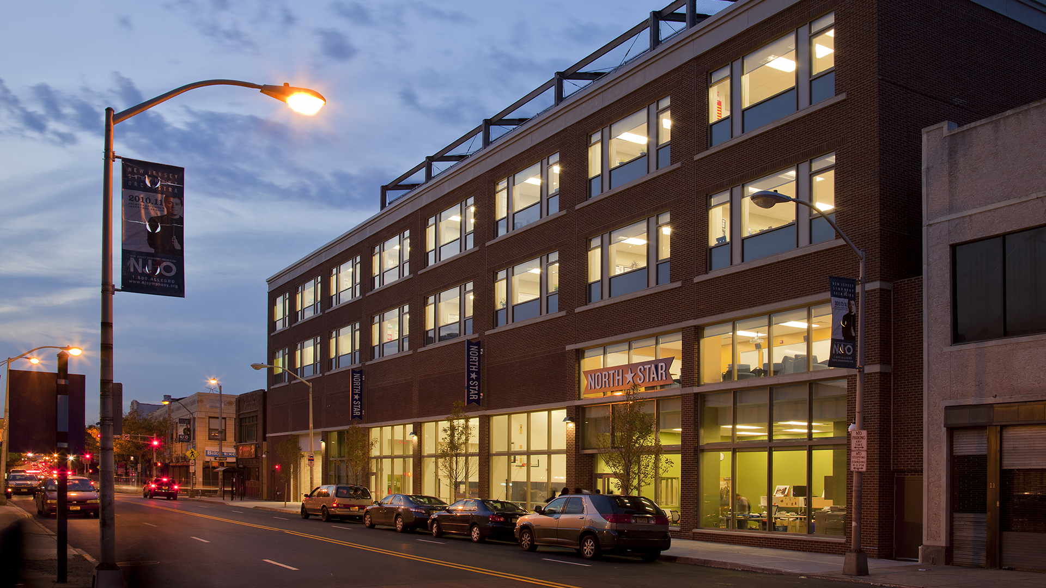
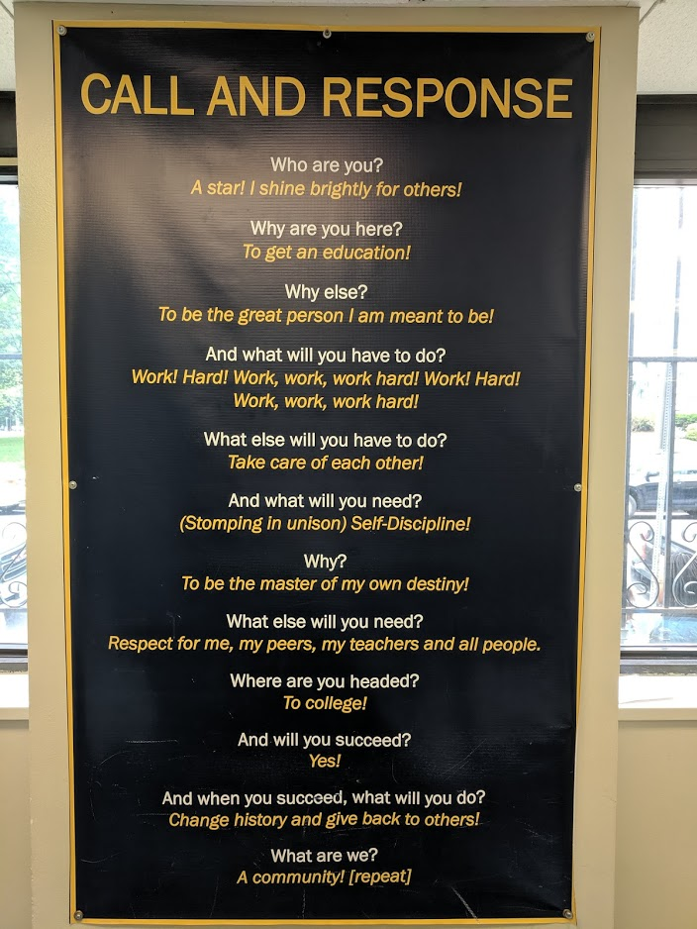
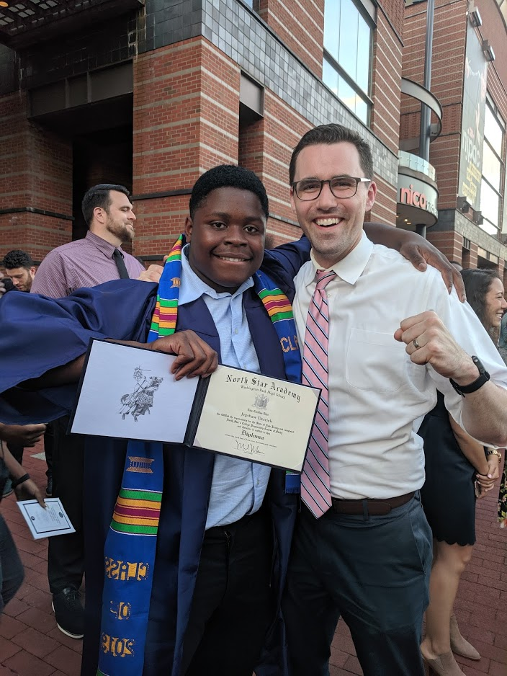
North Star Academy Washington Park HS

Slide 4
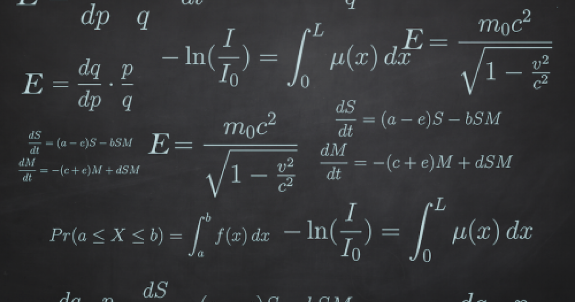
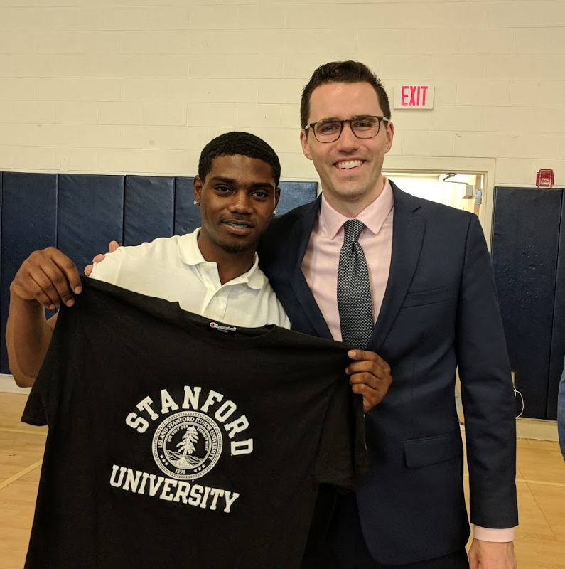

AP Calculus BC

Slide 5
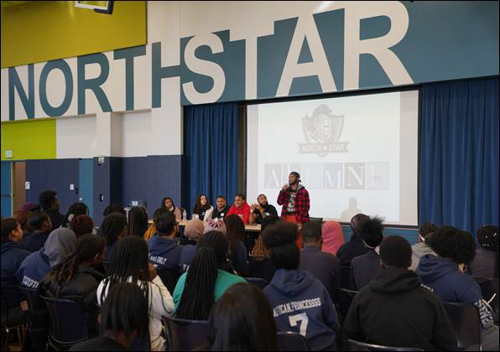
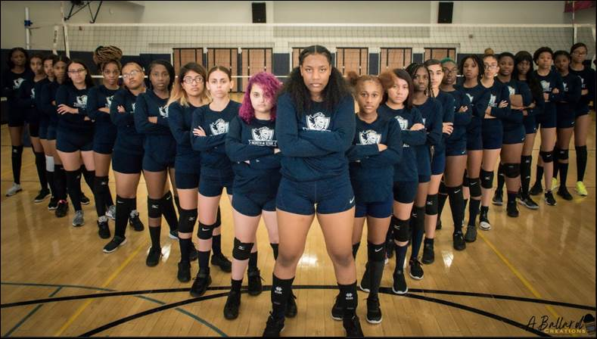
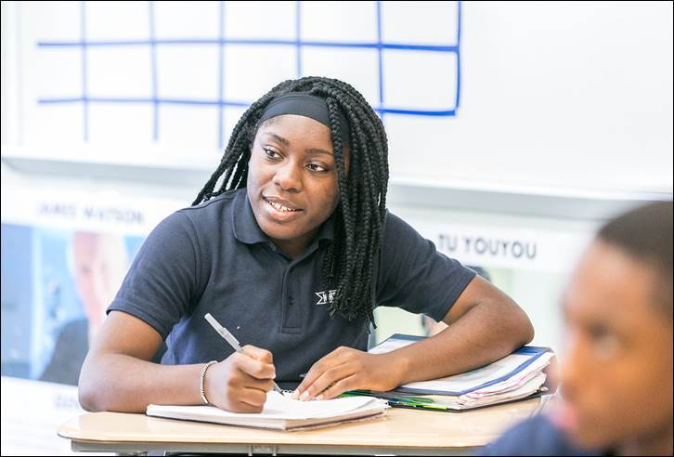
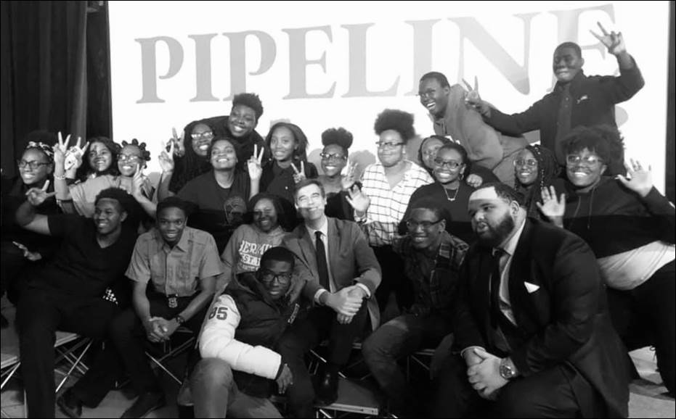
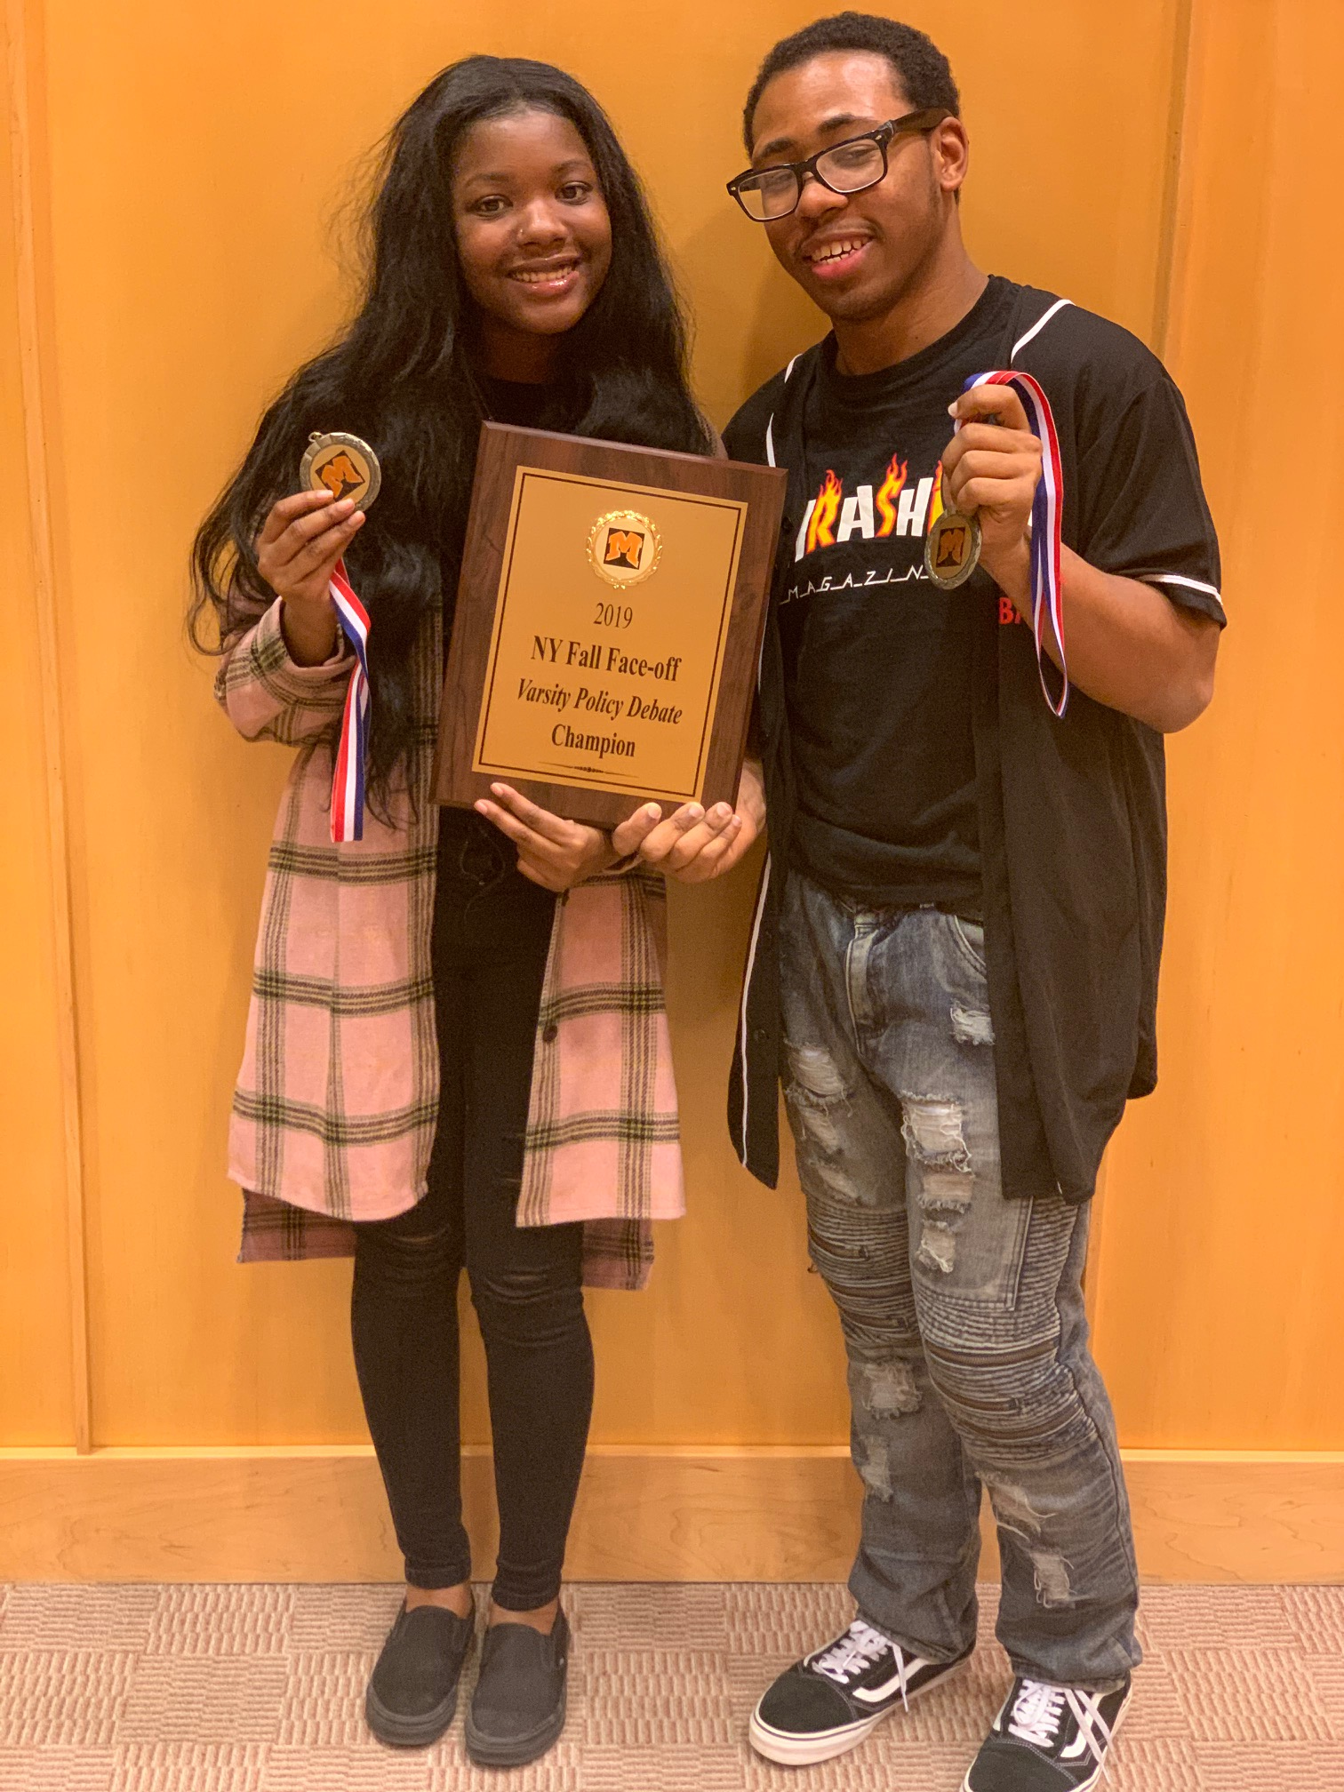
Students

Slide 6
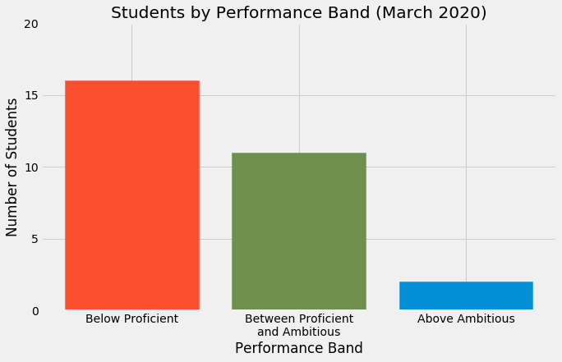
Overall Standards Mastery

Slide 7
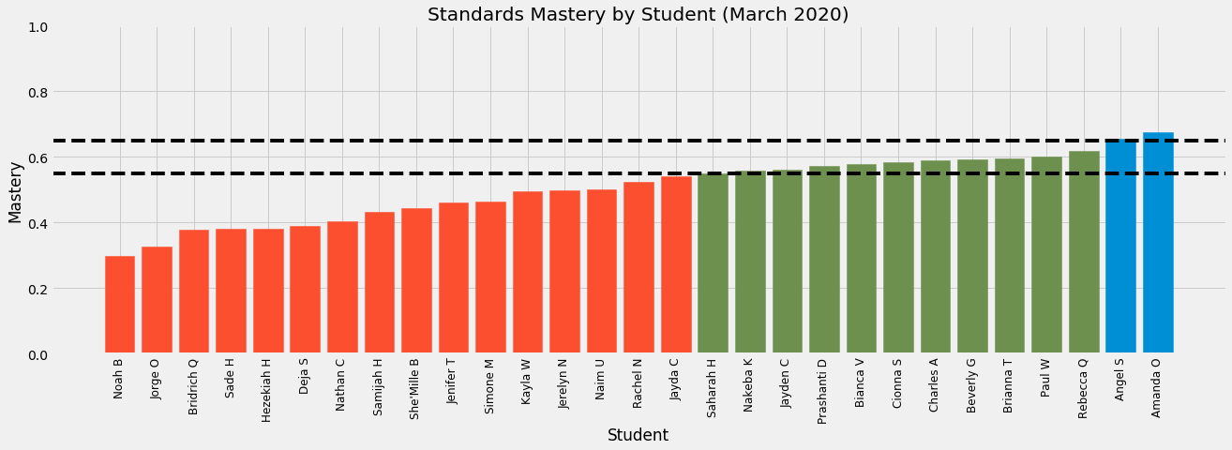
Mastery by Student

Slide 8
Research Question #1
How does a student’s previous math course impact standards mastery?

Slide 9
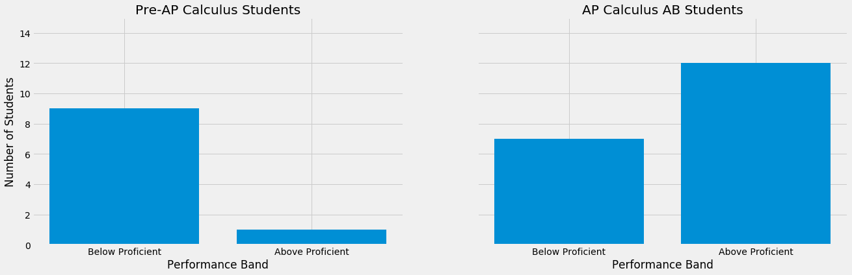
Research Question #1

Slide 10
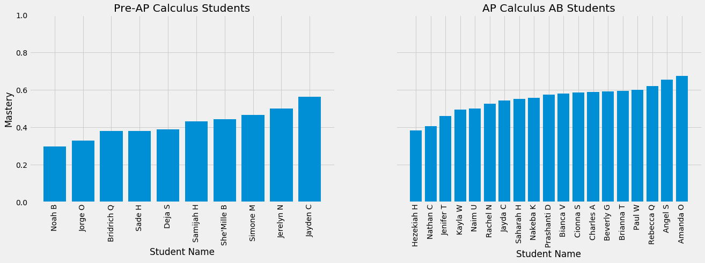
Research Question #1

Slide 11
Research Question #1
Insights!

Slide 12
Research Question #2
What character trait indicators based on self-assessment have the strongest correlation with standards mastery?

Slide 13
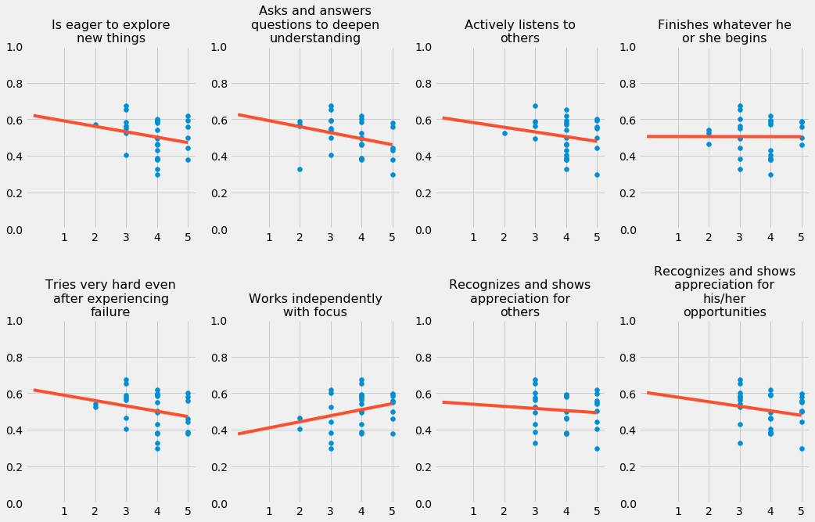
Research Question #2

Slide 14
Research Question #2
indicator | slope | intercept | r^2
Is eager to explore new things | -0.029655 | 0.620587 | 0.052376
Asks and answers questions to deepen understanding | -0.033073 | 0.625920 | 0.103636
Actively listens to others | -0.025687 | 0.607781 | 0.037672
Finishes whatever he or she begins | -0.000193 | 0.505732 | 0.000003
Tries very hard even after experiencing failure | -0.029129 | 0.617531 | 0.064941
Works independently with focus | 0.033331 | 0.376308 | 0.085028
Recognizes and shows appreciation for others | -0.011491 | 0.550602 | 0.008937
Recognizes and shows appreciation for his/her opportunities | -0.024846 | 0.602702 | 0.039347

Slide 15
Research Question #2
Insights!

Slide 16
My Perspective on Academic Results
Waiting on data narrative

Slide 17
Overall Character Results
Waiting on data narrative

Slide 18
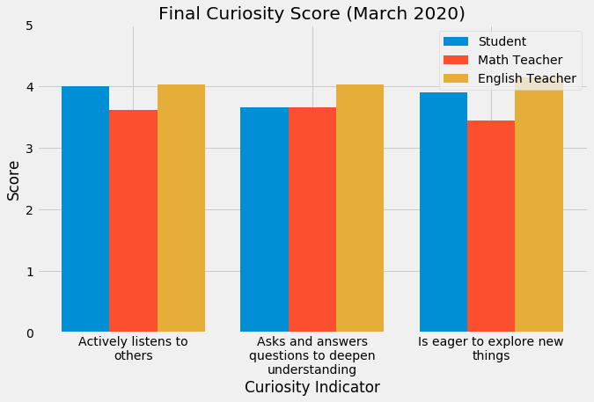
Character Results - Mastery

Slide 19
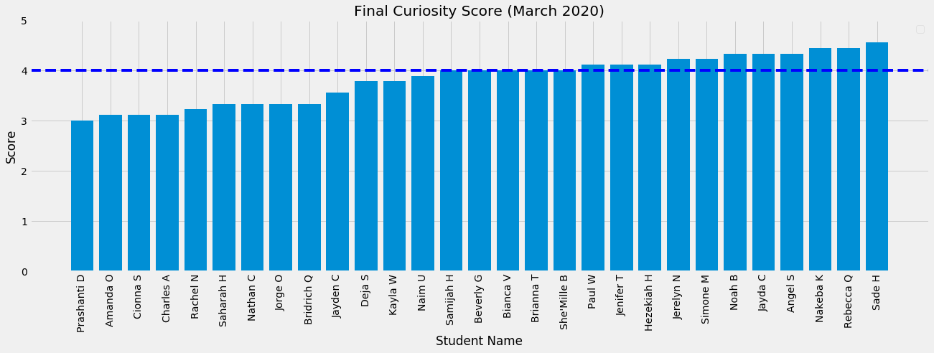
Character Results - Mastery

Slide 20
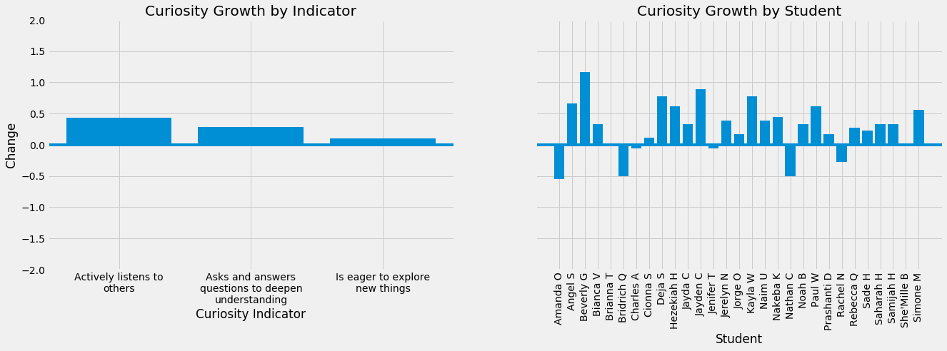
Character Results - Growth

Slide 21
My Perspective on Character Results
Waiting on data narrative

Slide 22
Portfolio Entry #1
Need to do portfolio first

Slide 23
Portfolio Entry #2
Need to do portfolio first

Slide 24
Portfolio Entry #3
Need to do portfolio first

Slide 25
Portfolio Entry #4
Need to do portfolio first

Slide 26
Key Insight #1
Need to think this out in long form first

Slide 27
Key Insight #2
Need to think this out in long form first

Slide 28
Thank you!
My students
Professor Hill
Professor Farnum
Professor Greene
Dean V
Jeffrey Duncan-Andrade
Zaretta Hammond
Doug Lemov
WPHS Math Department
Syrena Burnam
Mike Taubman
Beth Verrilli
Allison Johnson
Alyse Amato
Ashling Coffey
Anushae Syed
Poorvi Goradia
Julia Addeo
Michael Mann
Chris Palermo
Denarius Frazier
Nick Stano
Blake Sukar
Alissa Fong
Melissa Scheve
Allison Post
Cassidy Rosenblum
Mike Woodward
Alex Sylvester
Phil Berkaw
Rachel Gainer
Amanda Page
John Allenbach
Trevor Baisden
Michael and Machael Sherry
Jennifer Brown
Dean and Ross Coapman
Scott and Susan Coapman
Jack and Hope Sherry
Jack and Connie Coapman
Justine Coapman

Slide 29
Questions

